Slide 1
NeRF & CT Imaging
Qing Wu
wuqing@shanghaitech.edu.cn
ShanghaiTech University

Slide 2
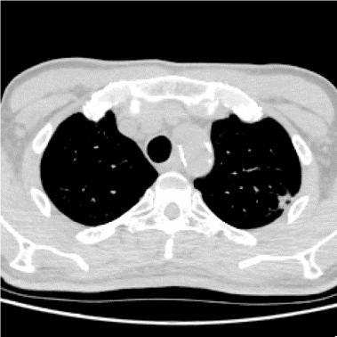

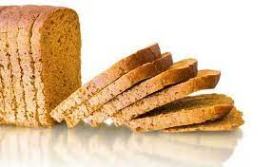
Computed Tomography (CT)
CT Images
Human Body

Slide 3
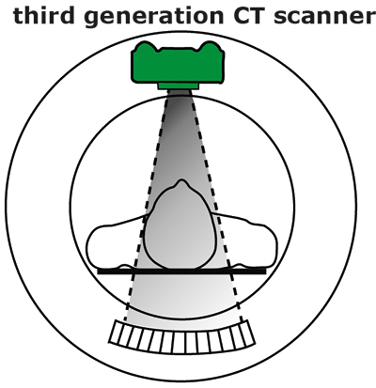
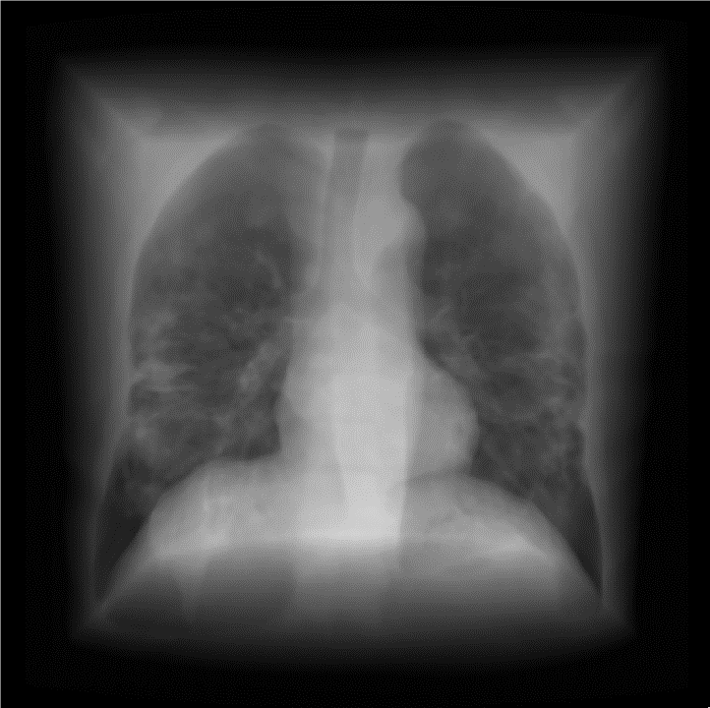
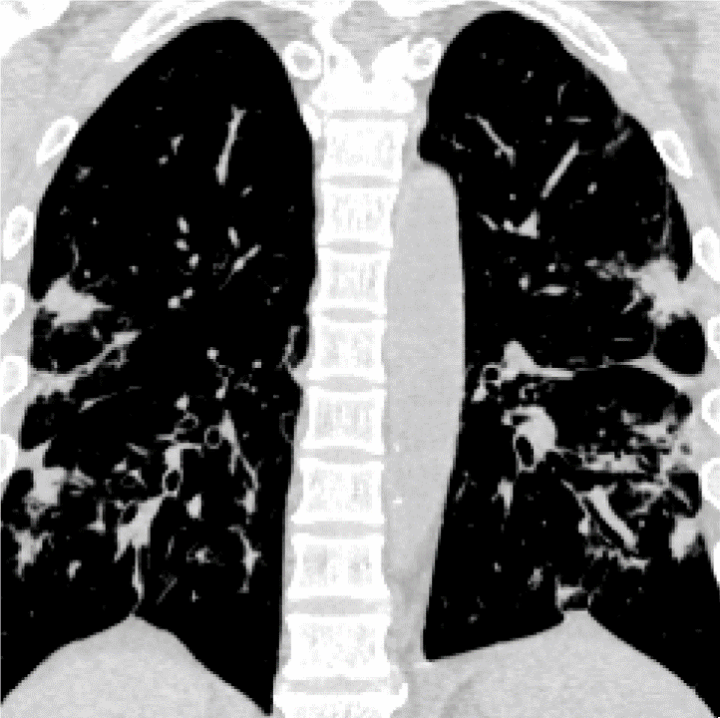
The Standard Pipeline of CT acquisition
Projecting X-rays from multiple views
Reconstructing CT image via filtered back-projection (FBP)
CT scanner
Sinogram
CT image

Slide 4

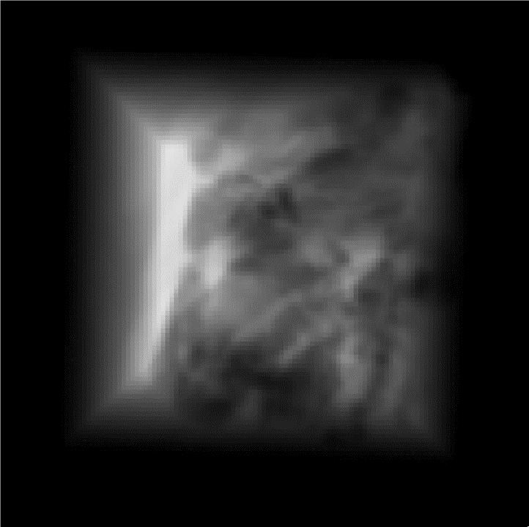
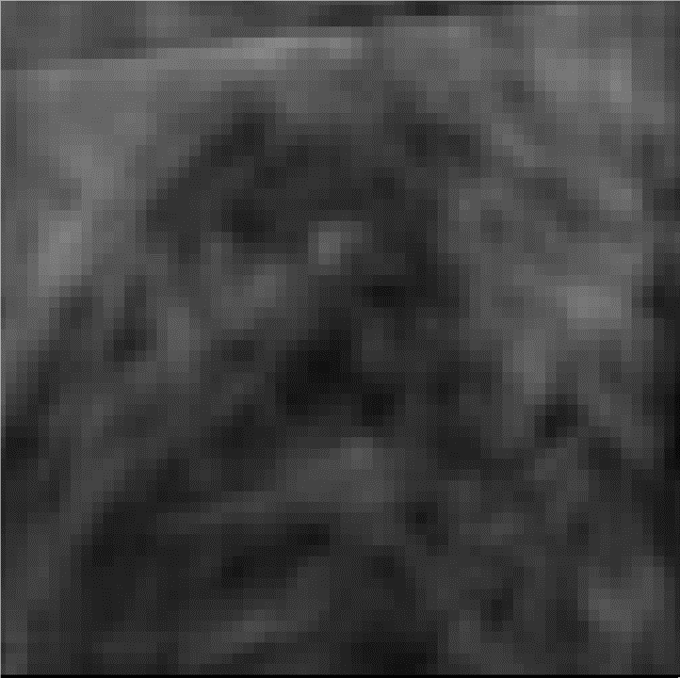
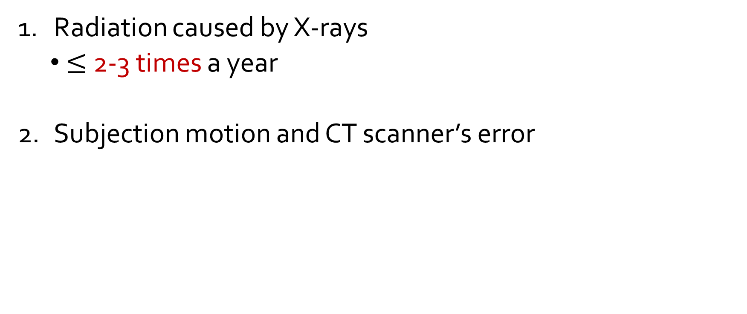
Two Problems in CT acquisition
Radiation caused by X-rays
$≤$ 2-3 times a year
Subjection motion and CT scanner’s error

Slide 5

Sparse-View (SV) CT for Reducing Radiation
Reducing the number of projection views
6x
180 views
30 views

Slide 6
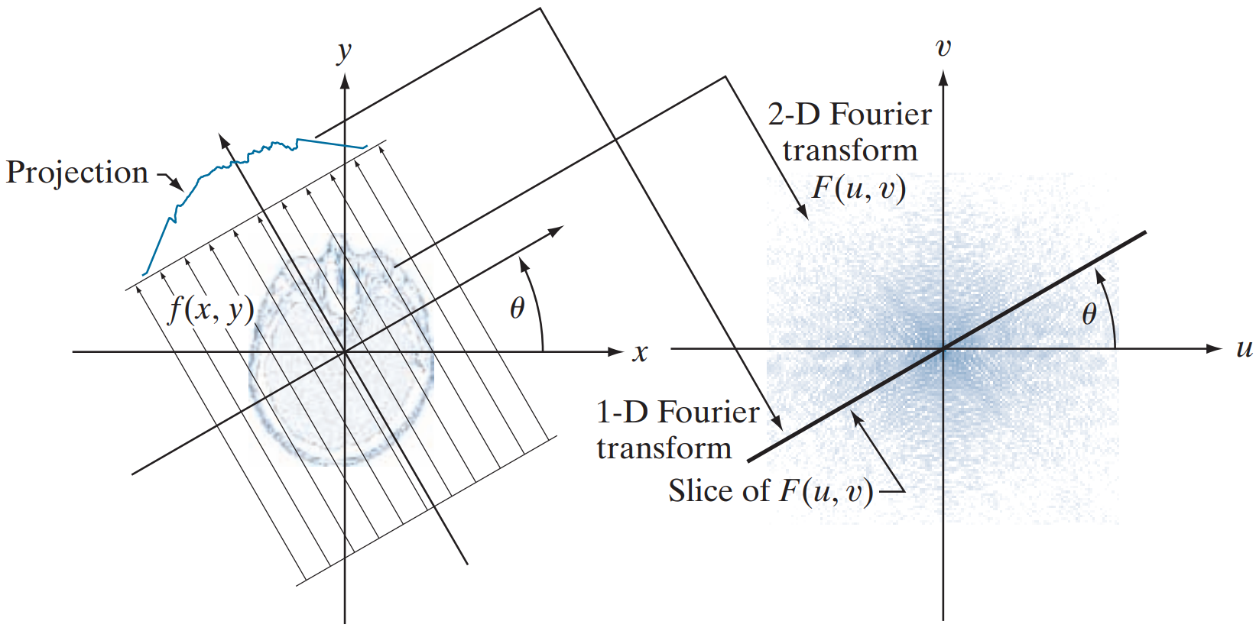
SVCT for Reducing Radiation
The central slice theorem

Slide 7
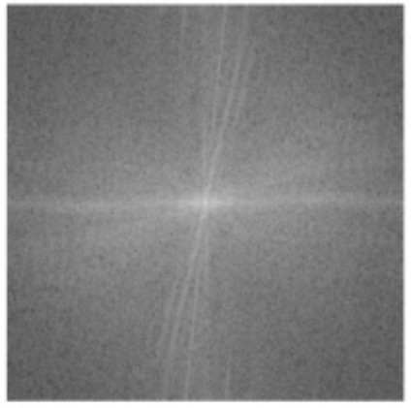
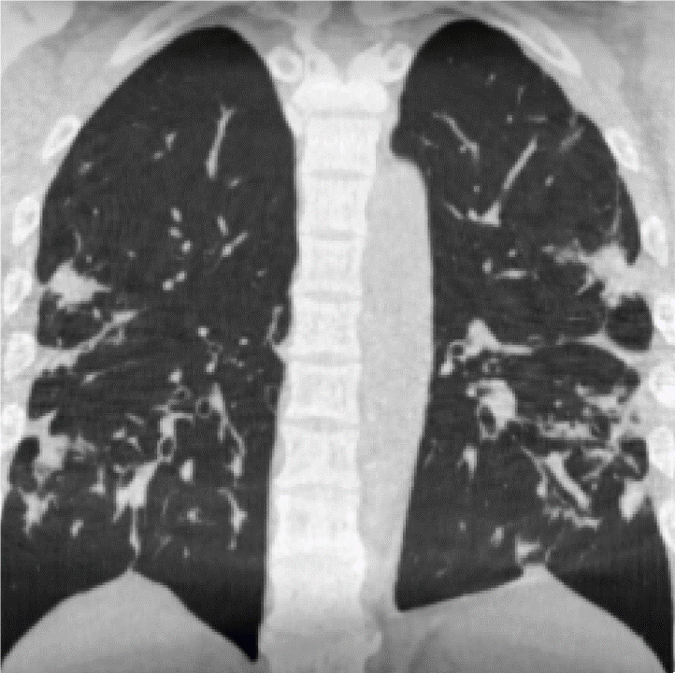
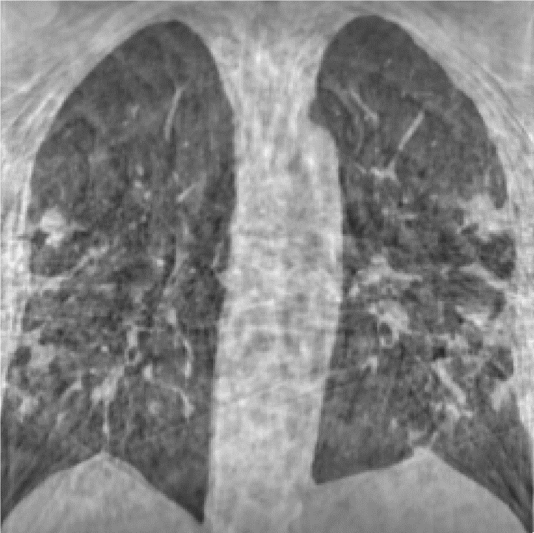
SVCT for Reducing Radiation
SV projections result in severe streaking artifacts
180 views
30 views

Slide 8
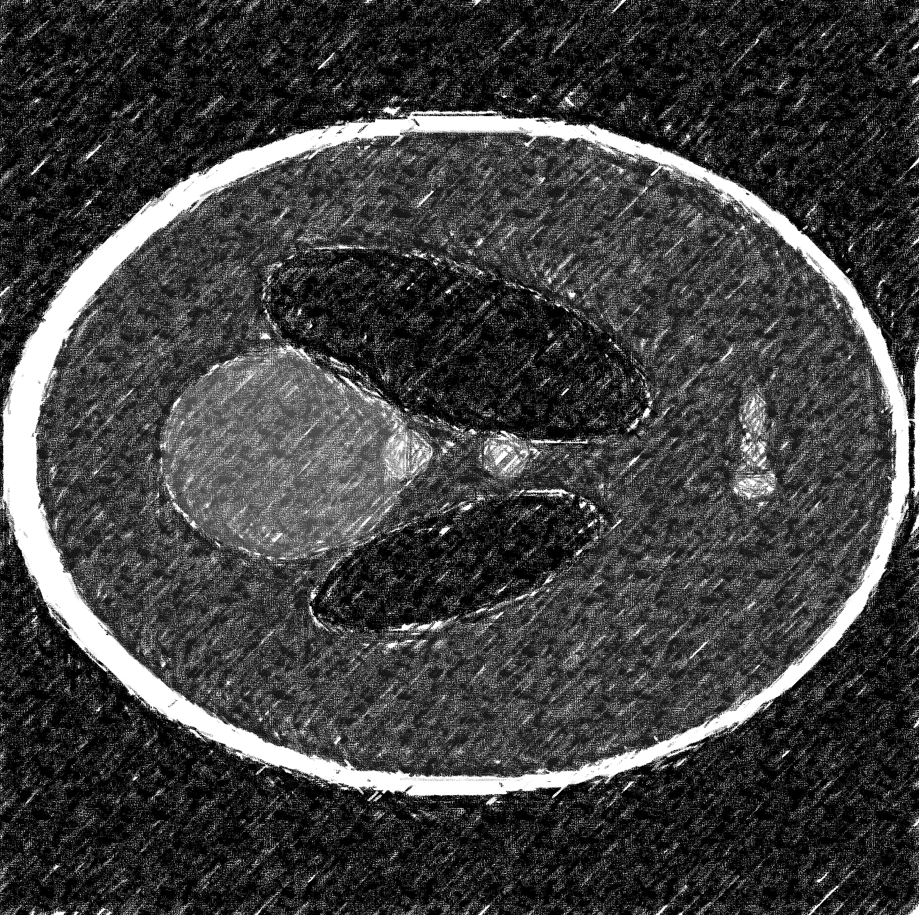

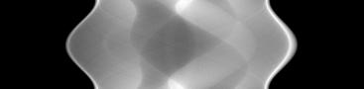
Supervised Method for SVCT
Image-domain based models (Image Denoising)
Sinogram-domain based models
Cross-domain based models
FBP
CNN Model
SV Sinogram
Low-quality
CT image
Artifacts-free
CT image

Slide 9
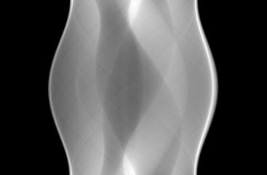
Supervised Method for SVCT
Image-domain based models
Sinogram-domain based models (Image Interpolation)
Cross-domain based models
CNN Model
FBP
SV Sinogram
DV Sinogram
Artifacts-free
CT image

Slide 10
Supervised Method for SVCT
Image-domain based models
Sinogram-domain based models
Cross-domain based models (Image Translation)
CNN Model
SV Sinogram
Artifacts-free
CT image

Slide 11
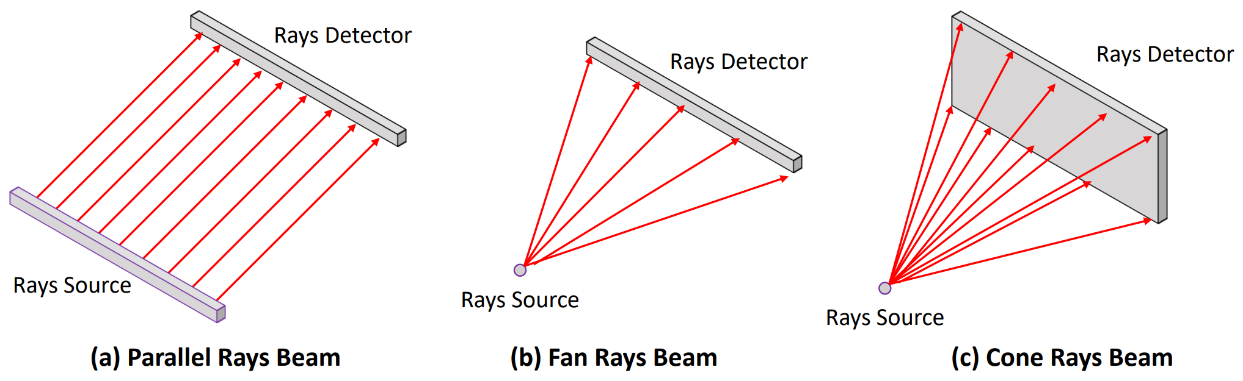
Supervised Method for SVCT
Two Common Limitations
Need for a large-scale dataset
Model generalization (Types of X-ray Beam)

Slide 12
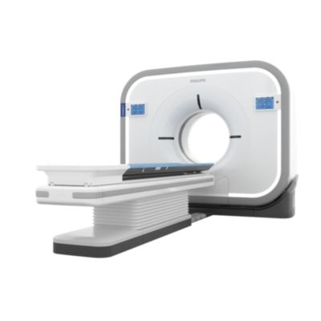
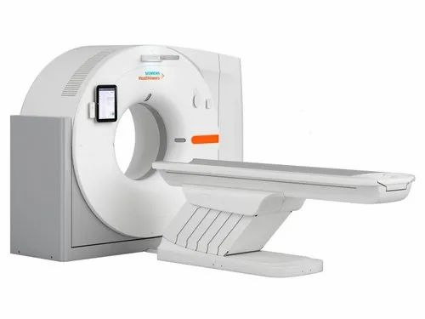
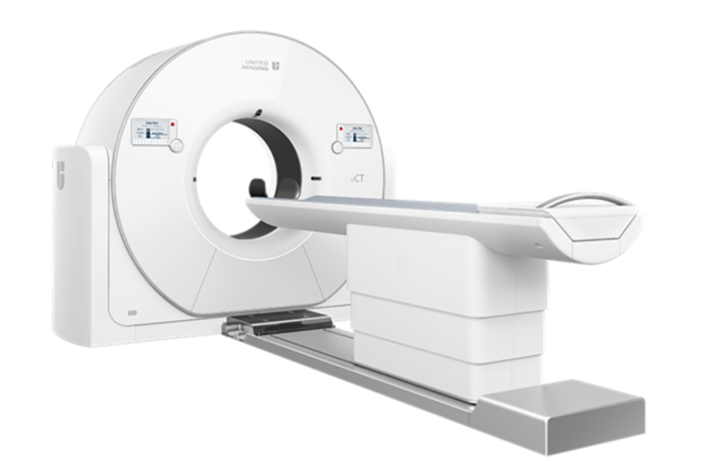
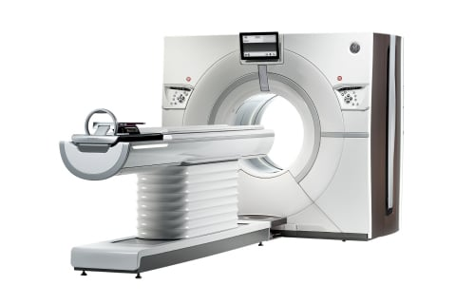
Supervised Method for SVCT
Two Common Limitations
Need for a large-scale dataset
Model generalization (CT scanners)
Siemens
GE
Philips
United Imaging

Slide 13
Motivation
Recovering high-quality CT images from the acquired SV sinograms without extra data
Model
SV Sinogram
Artifacts-free
CT image

Slide 14
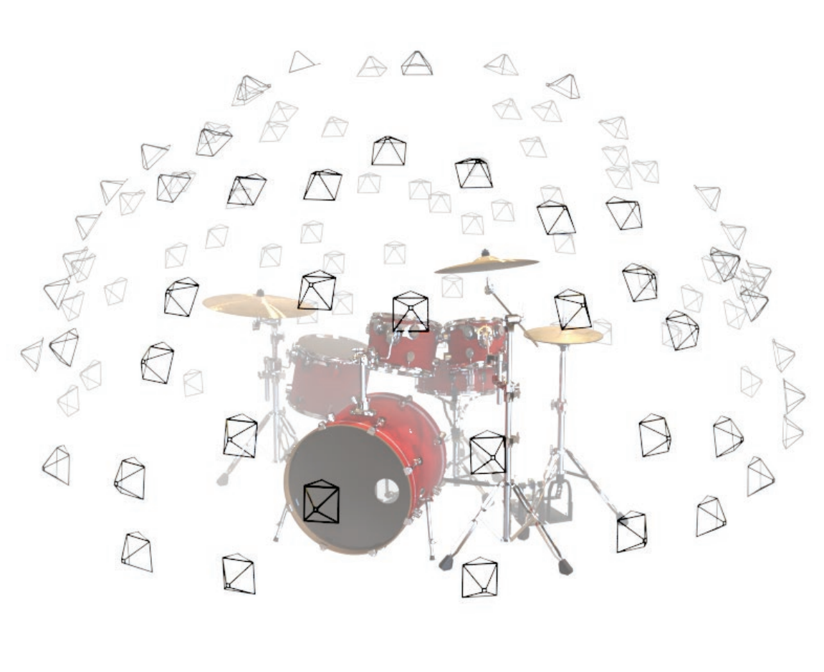
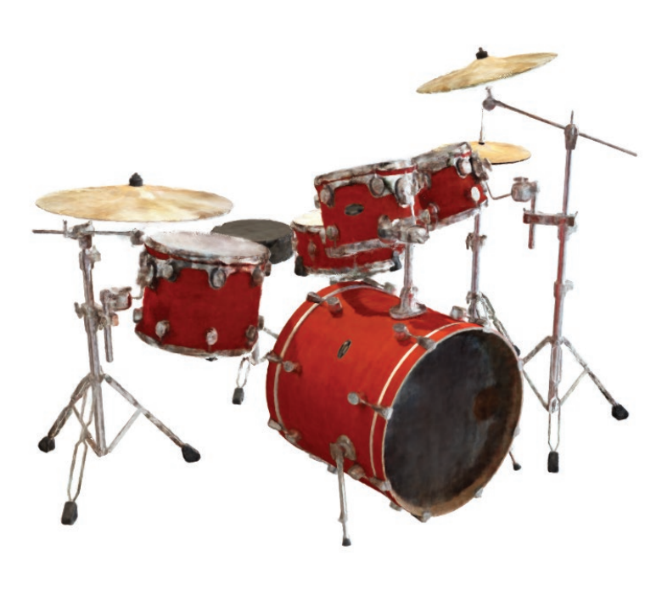
Neural Radiance Field (NeRF)
Synthesizing arbitrary views

Slide 15
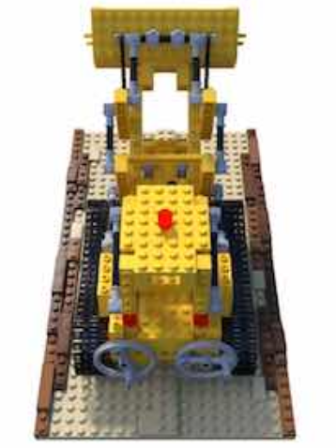
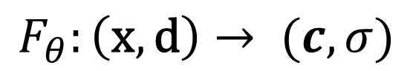
Neural Radiance Field (NeRF)
Representing the field (3D object) as a continuous function
Based on the 2D images, using an MLP to learn the function.
Color (RGB)
3D coordinate
$$F_{θ}:\left(\text{x},\text{d}\right)→ (c,σ)$$
Density
2D direction

Slide 16
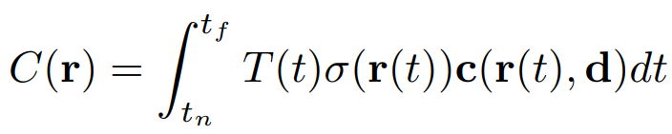
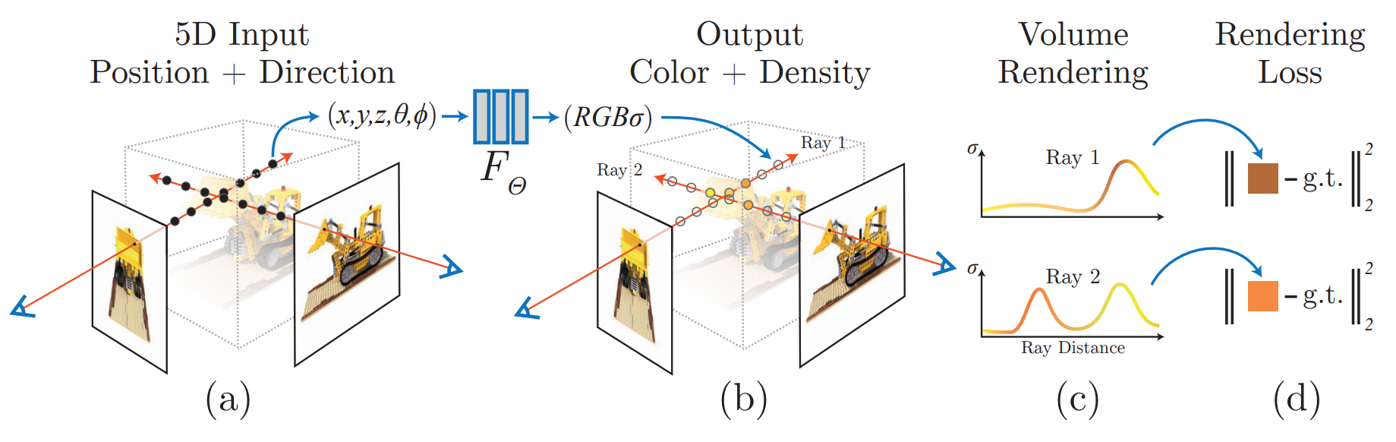
Neural Radiance Field (NeRF)
Pipeline
field (3D object) domain
measurement (image) domain

Slide 17
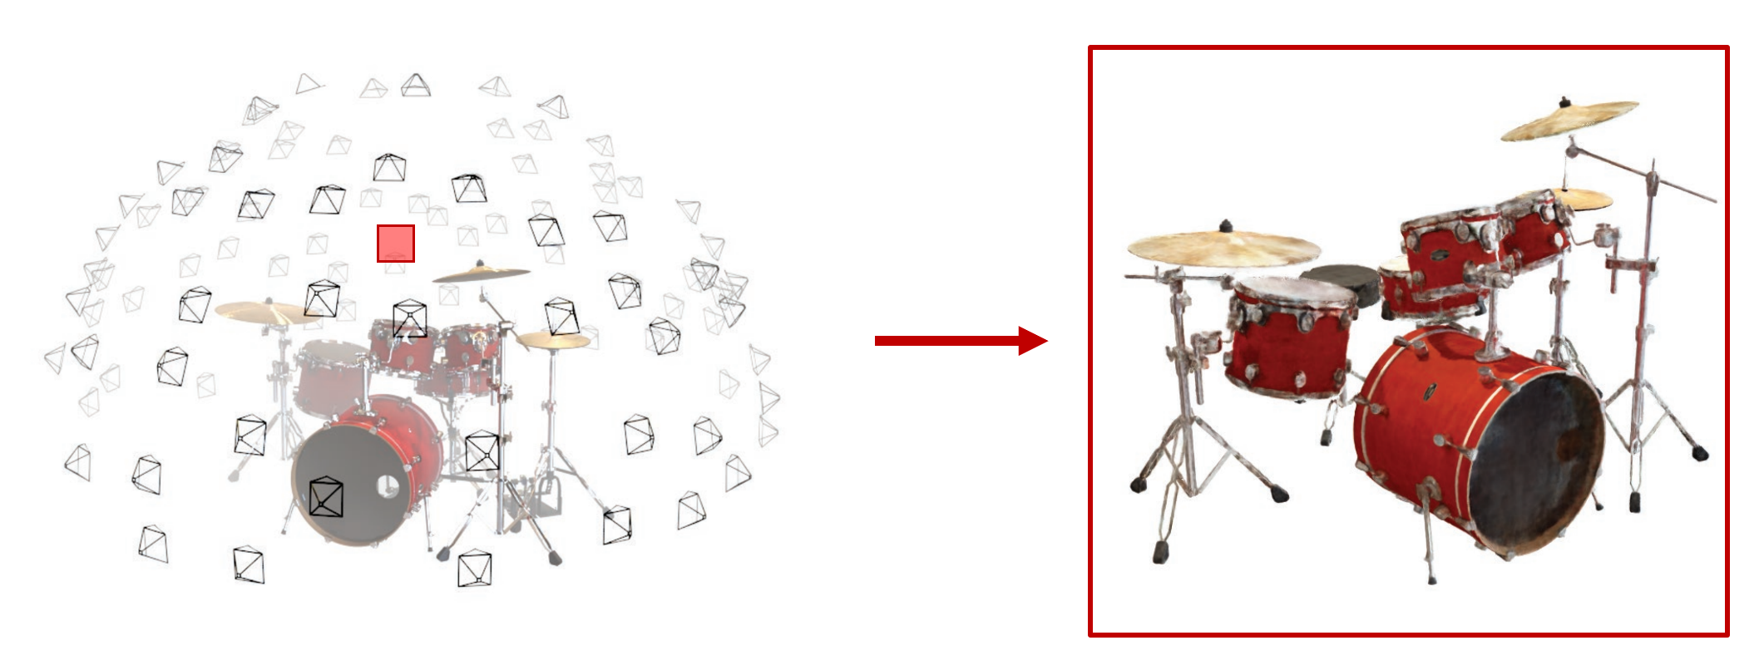
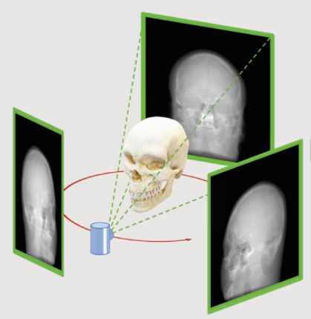
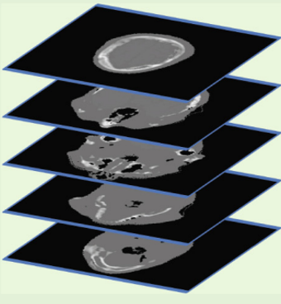
Neural Radiance Field (NeRF)
Main commons and differences between view synthesis and SVCT
Input: 2D images
Output: 2D images
Input: 2D projections
Output: 3D volume

Slide 18
NeRF-based SVCT Models
CoIL (10.1109/TCI.2021.3125564)
NAF (10.1007/978-3-031-16446-0_42)
SCOPE (10.48550/arXiv.2209.05483)

Slide 19
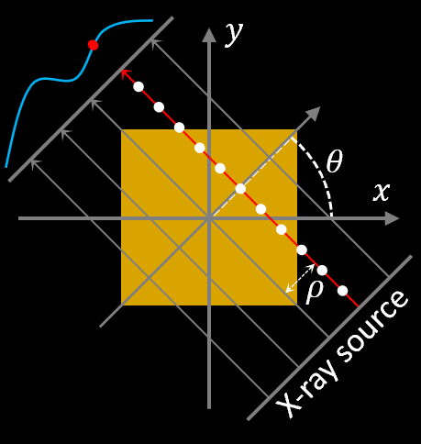
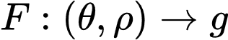
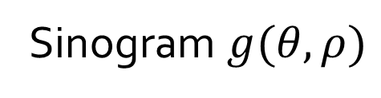
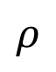
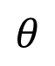
CoIL: Coordinate-Based Internal Learning
Represent the sinogram as a continuous function:
Projection
value
Projection view
$$θ$$
$$ρ$$
X-ray Position
Sinogram $g(θ,ρ)$

Slide 20
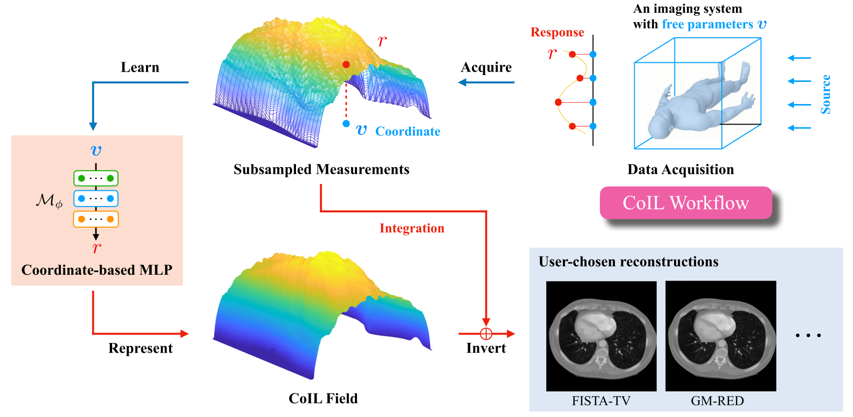
CoIL: Coordinate-Based Internal Learning

Slide 21
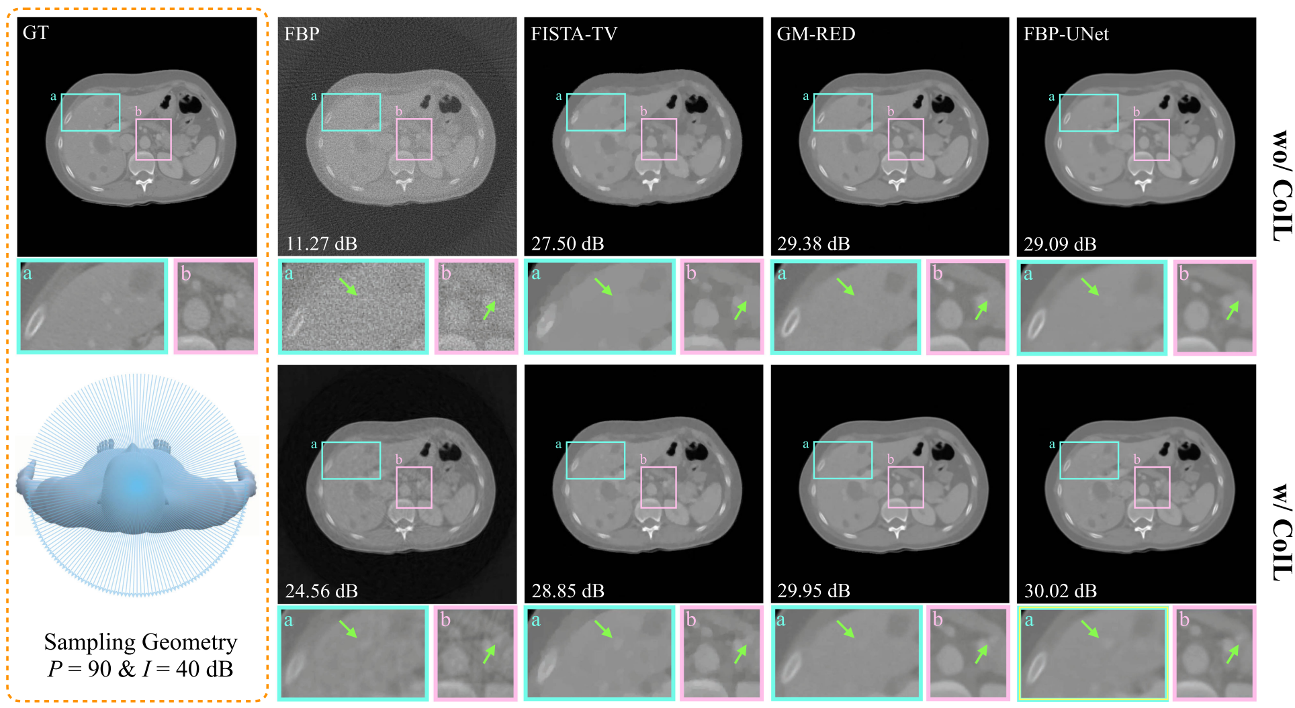
CoIL: Coordinate-Based Internal Learning

Slide 22
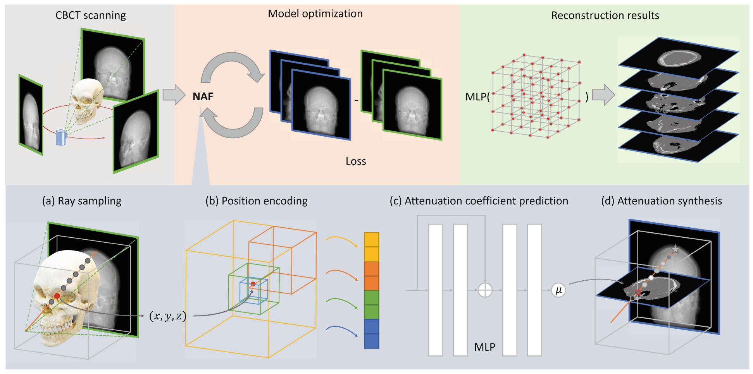
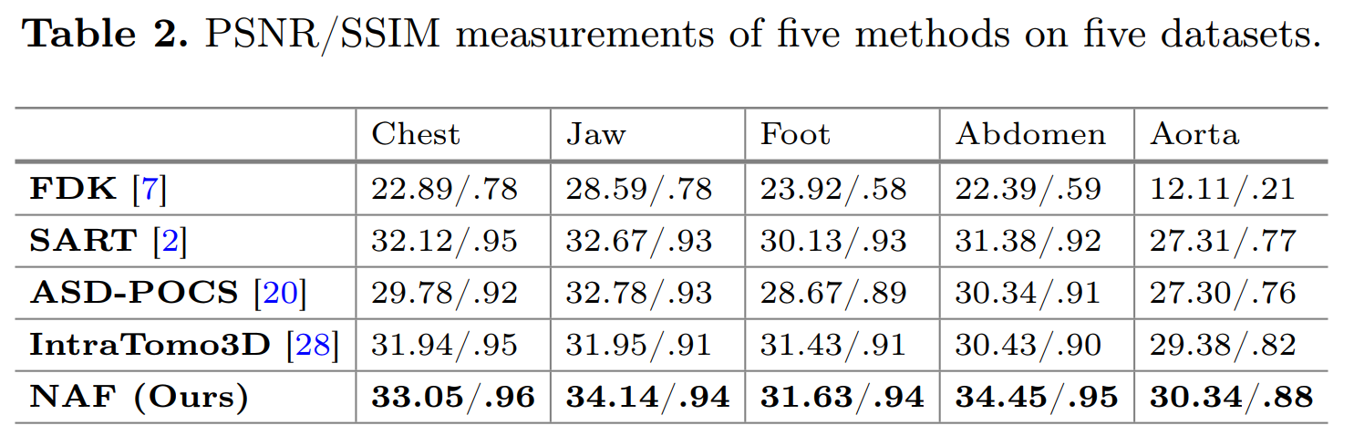
NAF: Neural Attenuation Fields

Slide 23
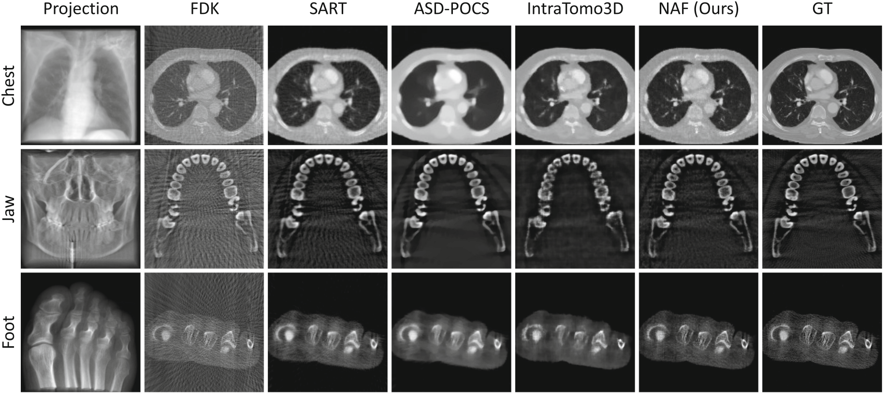
NAF: Neural Attenuation Fields

Slide 24
NAF: Neural Attenuation Fields

Slide 25
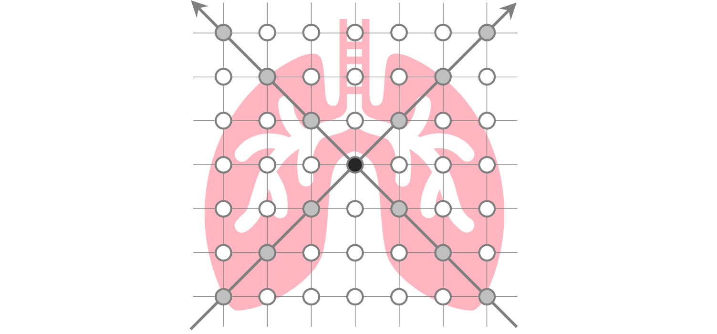
SCOPE: Self-Supervised Coordinate Projection Network
Following original NeRF will produce many noises in results

Slide 26
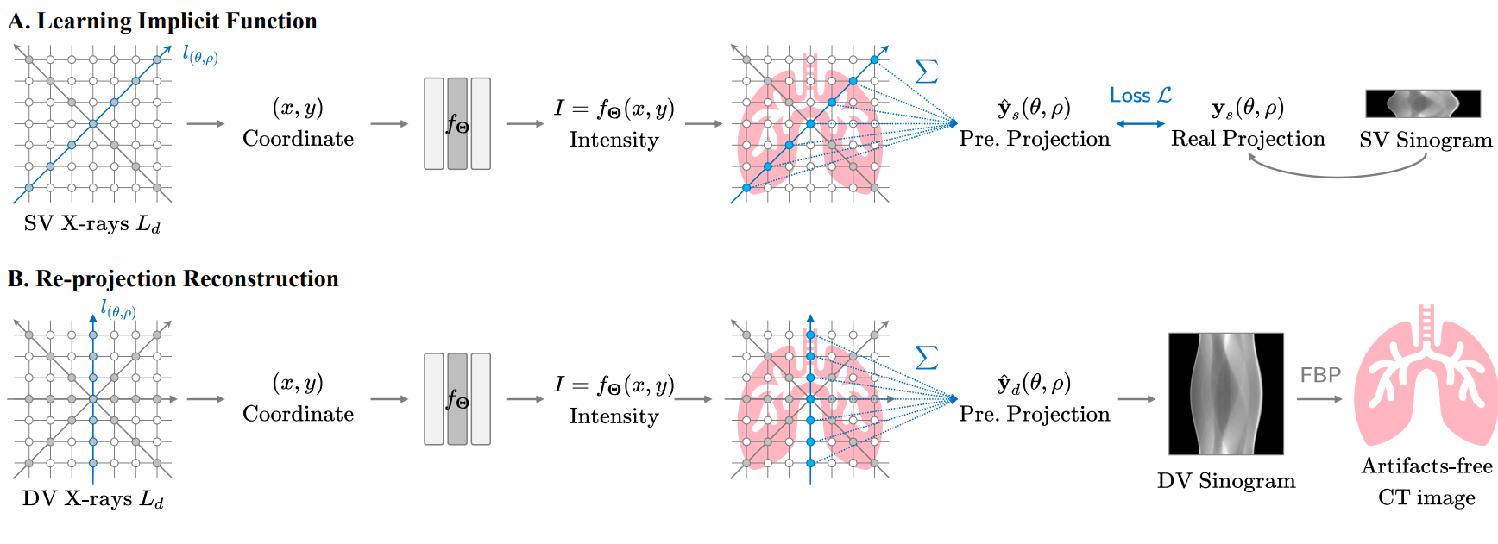
SCOPE: Self-Supervised Coordinate Projection Network

Slide 27
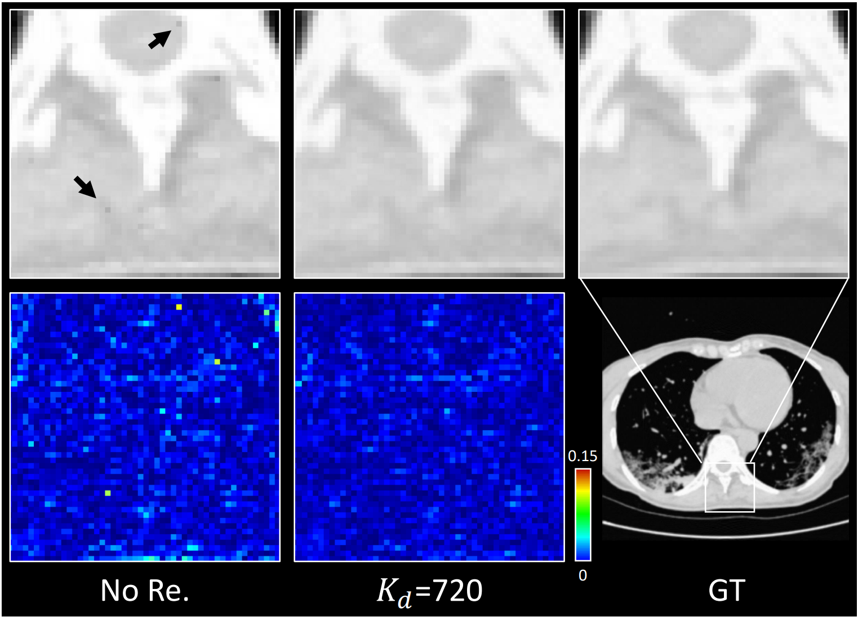
SCOPE: Self-Supervised Coordinate Projection Network

Slide 28
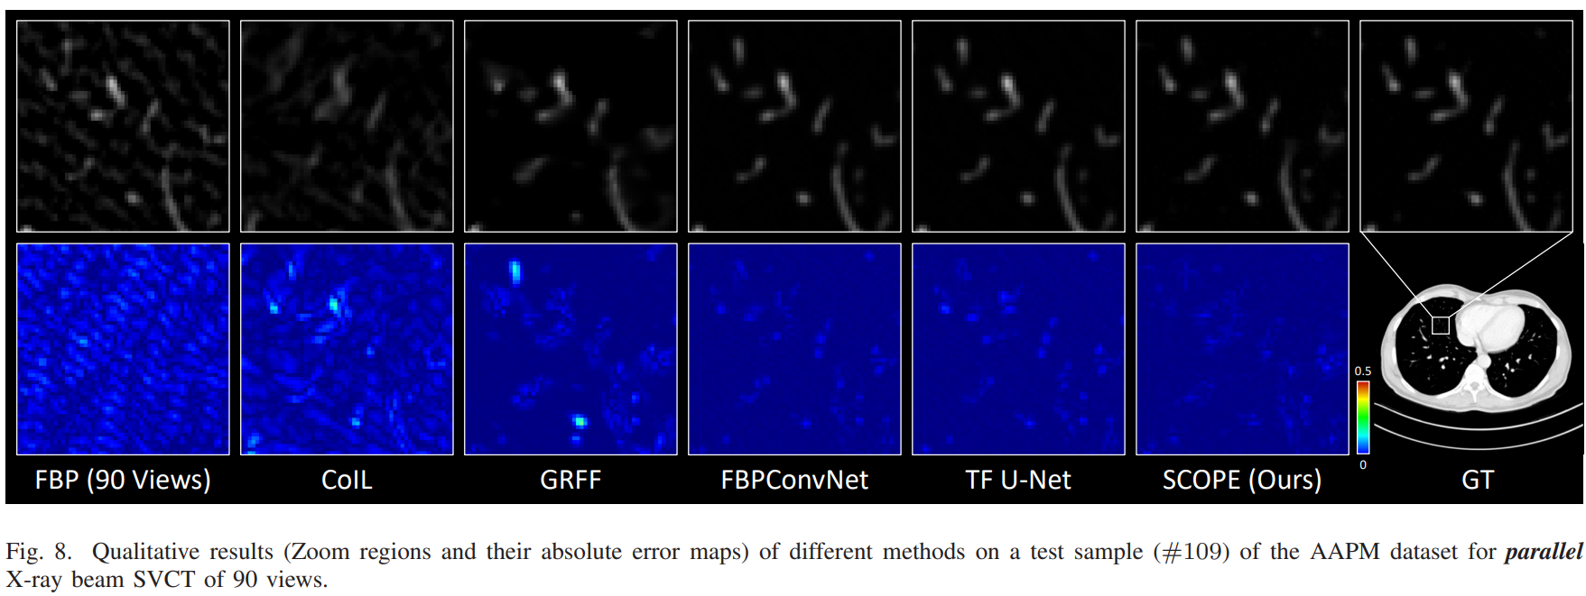
SCOPE: Self-Supervised Coordinate Projection Network

Slide 29
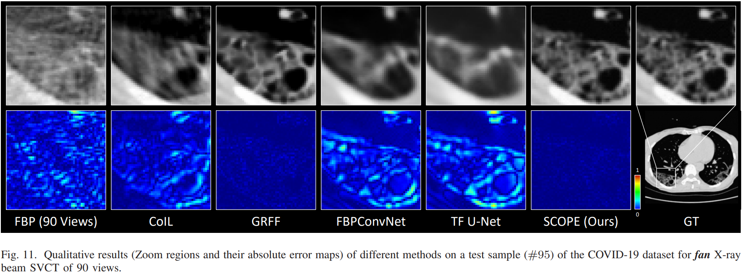
SCOPE: Self-Supervised Coordinate Projection Network

Slide 30
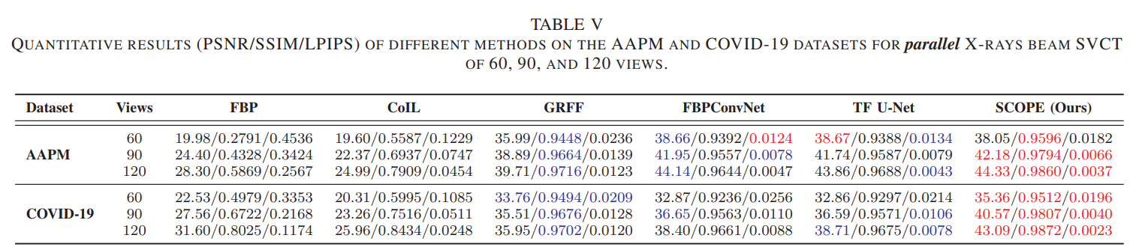
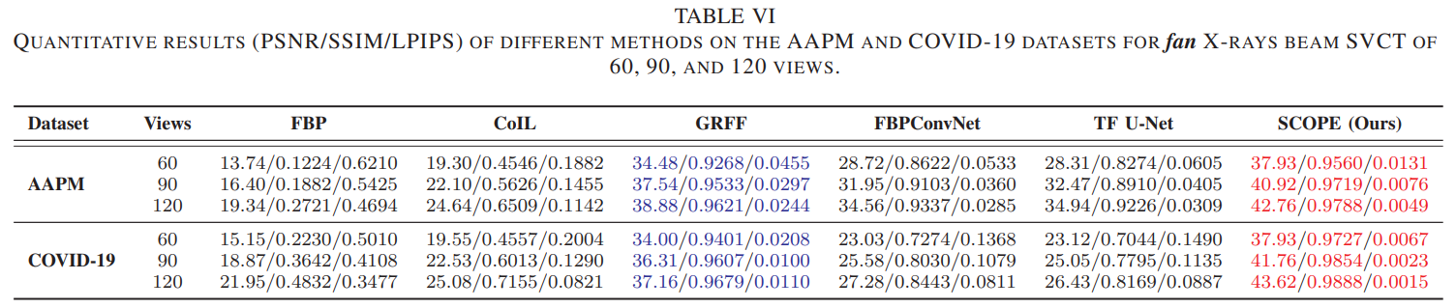
SCOPE: Self-Supervised Coordinate Projection Network

Slide 31
Summary for NeRF-based SVCT methods
Data Requirements
Only require a single SV sinogram
Performance
Produce robust performance for diverse CT settings.
Outperforms supervised deep learning models
Speed
Take 1 min for a CT image of 512*512 on a single NVIDIA RTX 3060 GPU

Slide 32
SVCT with Rigid Motion
Subjection motion and CT scanner’s error

Slide 33
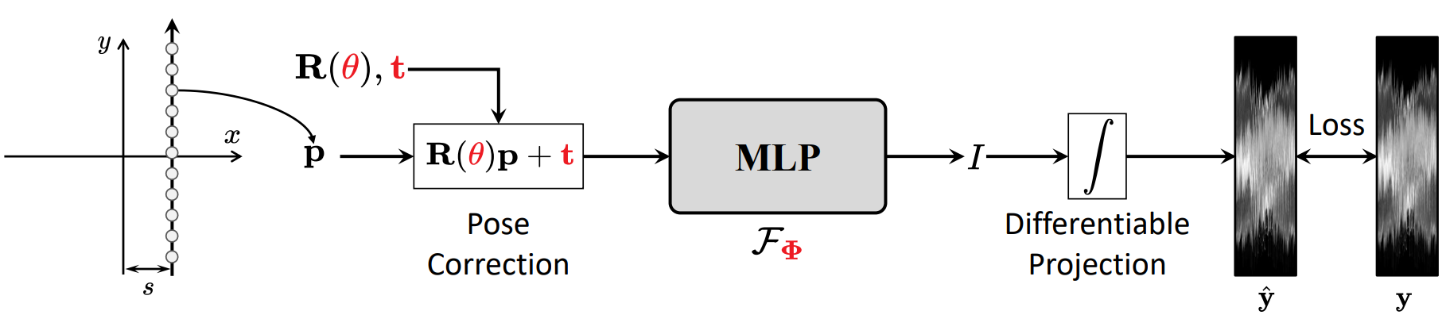
SVCT with Rigid Motion
Optimizing pose and neural network simultaneously

Slide 34
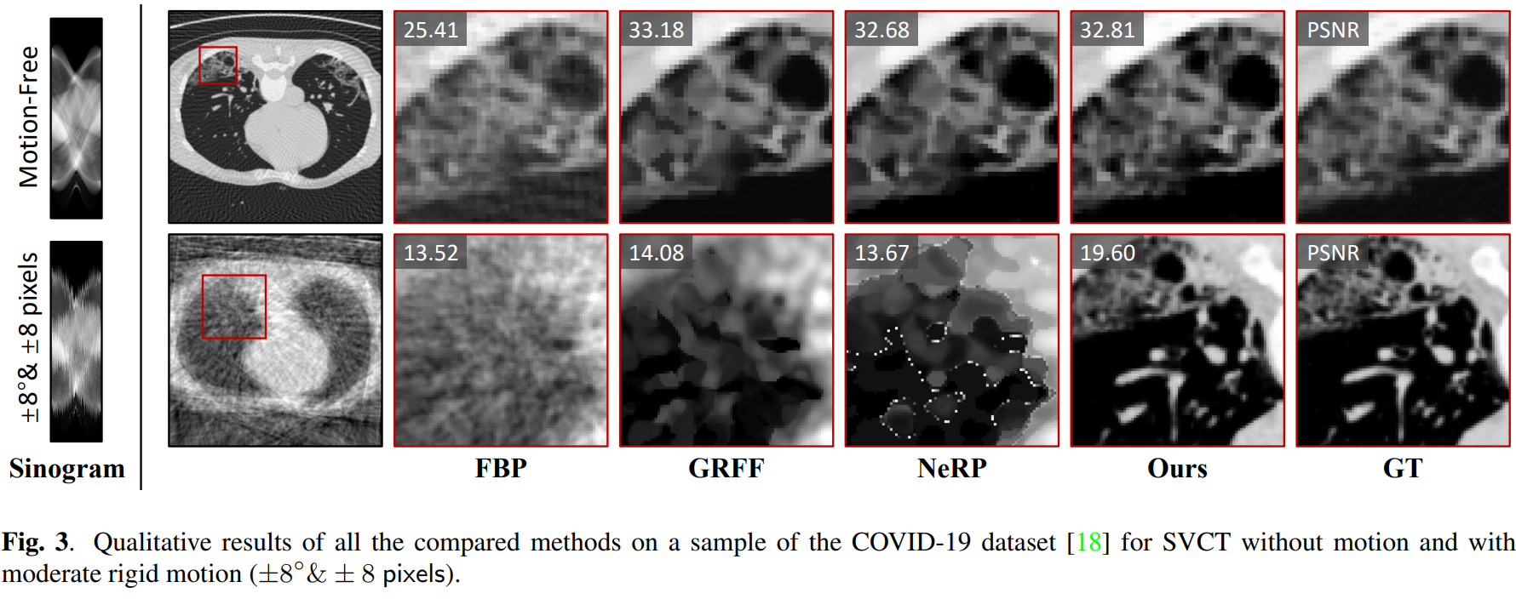
SVCT with Rigid Motion

Slide 35
Thanks！
Qing Wu
wuqing@shanghaitech.edu.cn
ShanghaiTech University

